Slide 1


Slide 2


Slide 3

You see the needs of children and families around you and around the world, and you want to do something. You want to make a difference.

Slide 4
You are compassionate.
You are faith, hope and love in action.
Acting in humility, you seek service in the name of a loving God.

Slide 5
You are filled with passion to help the helpless, defend the defenseless and love the unloved.
Just as He did.
You are a need met, a prayer answered and a life redeemed.

Slide 6
You mean hope.

Slide 7


Slide 8

Buckner International is a faith-based nonprofit ministry dedicated to transforming the lives of orphans, vulnerable children, families and senior adults in the United States and internationally.

Slide 9
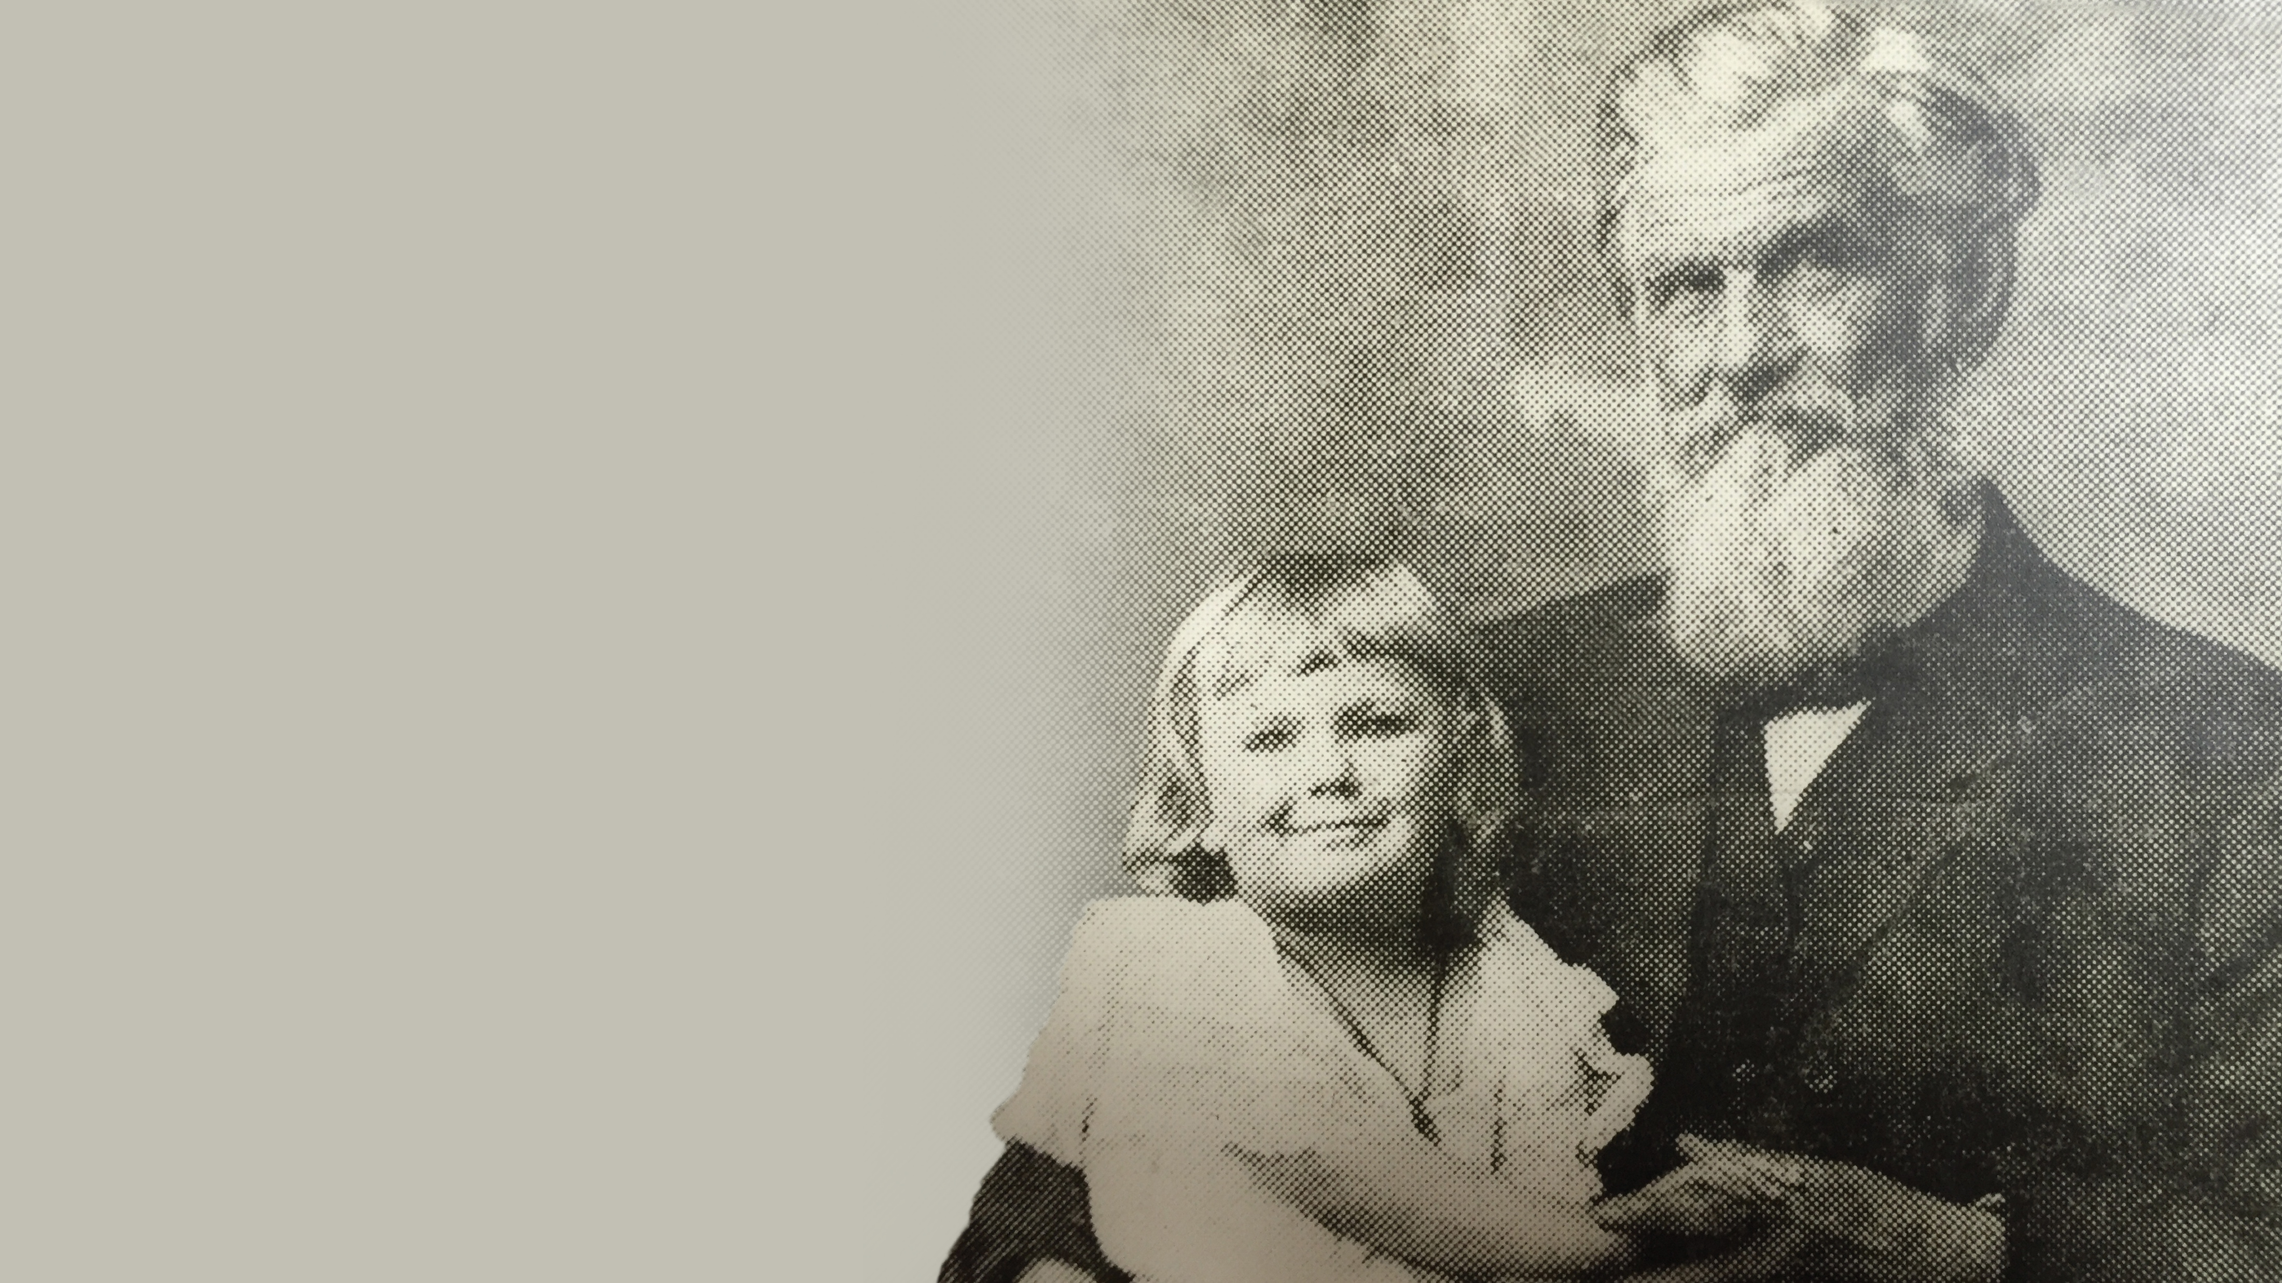
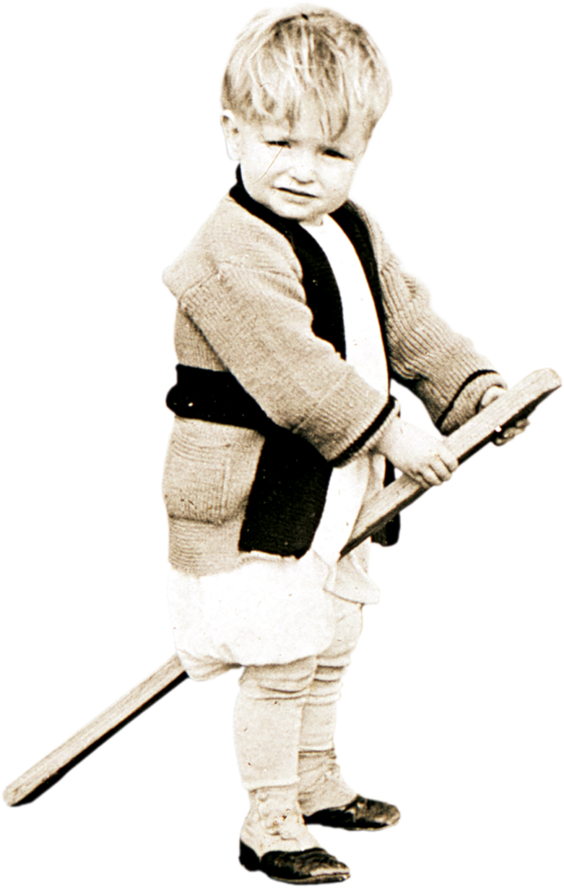
Founded in 1879, Buckner serves people through a variety of programs designed to protect children and build
strong families.
Buckner International started when Robert Cooke Buckner a pastor moved by compassion for the fatherless in the wake of the Civil War, began a movement in 1879 to give hope to orphans and those most in need.

Slide 10
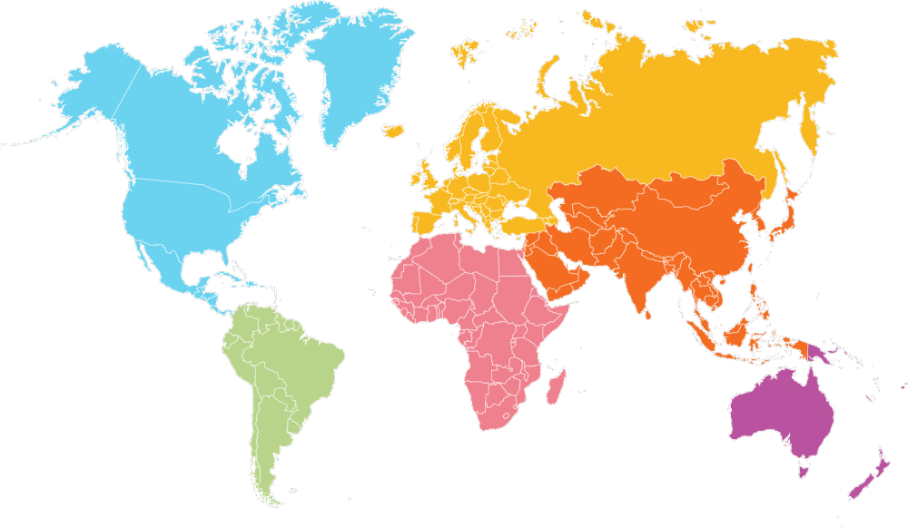

Buckner is unique!
When you work with Buckner, you’re working with a unique organization that provides holistic ministries to vulnerable children and struggling families, as well as to senior adults.

Slide 11



We have deep, enduring values, seeking to:

Slide 12
Join us and minister in ways that meet deep needs and lead to self-sufficiency, using programs that:
Educate
Support
Care
Empower

Slide 13
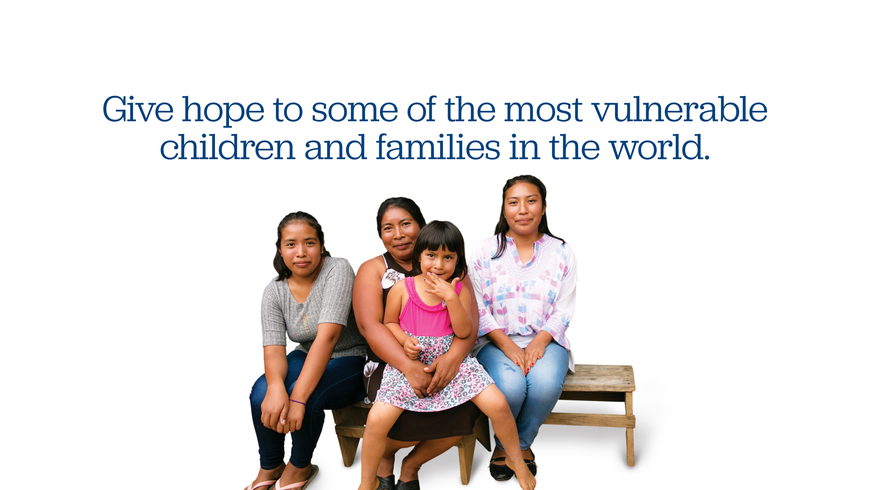

Slide 14

We join with volunteers, organizations and
businesses to respond to people in need.

Slide 15
Most of our volunteers are driven by compassion
and a call to seek justice.

Slide 16
We want everyone to know Christ and His
Good news and work with people compelled
by their faith to serve others.

Slide 17


Slide 18

To better serve vulnerable children, families and senior adults, we work with you to offer many life-impacting options. Together, we can serve through:

Slide 19

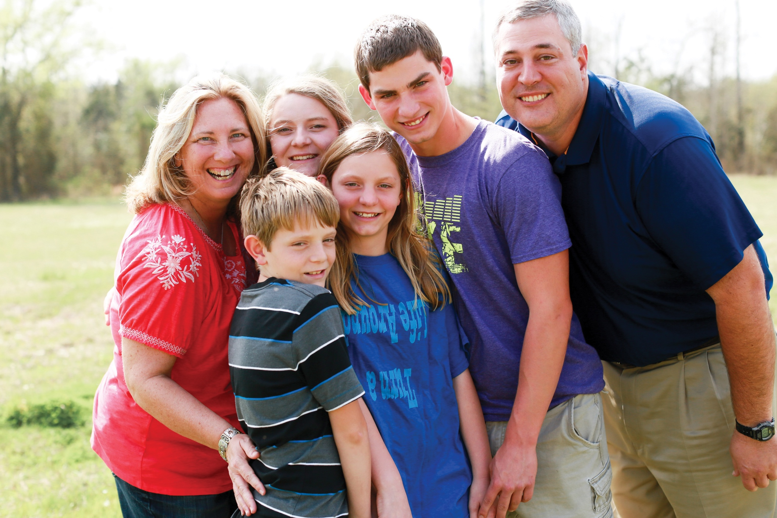
Foster Care and Adoption.
Be a family for vulnerable children in need of safety and love.

Slide 20

Family Pathways.
Help families stay together by providing affordable housing and support to single parents seeking higher education.

Slide 21

Family Hope Centers.
Join us to offer a range of services from counseling to computer classes in communities where vulnerable children and families live.

Slide 22

Senior Living.
Explore how we enrich the lives of the aging population with a continuum of services including independent living, assisted living, nursing, memory care and hospice.

Slide 23

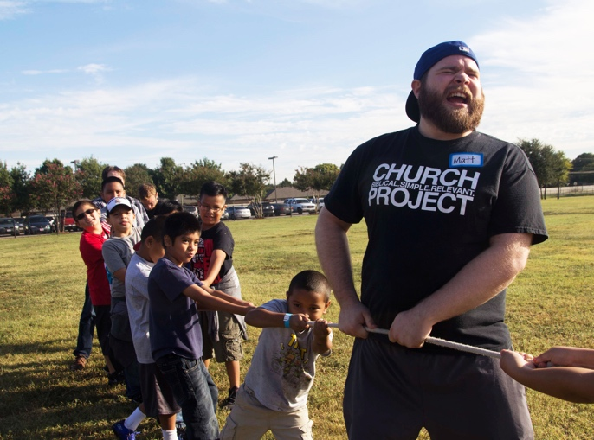

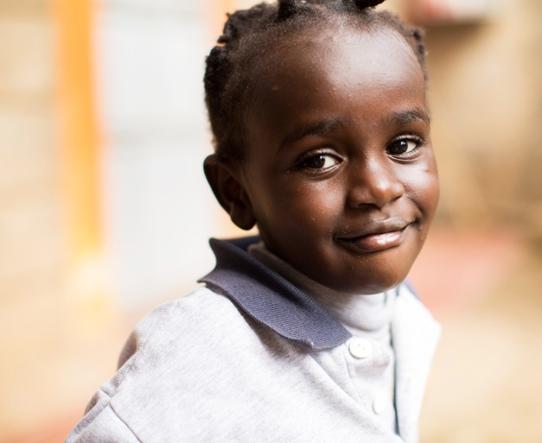
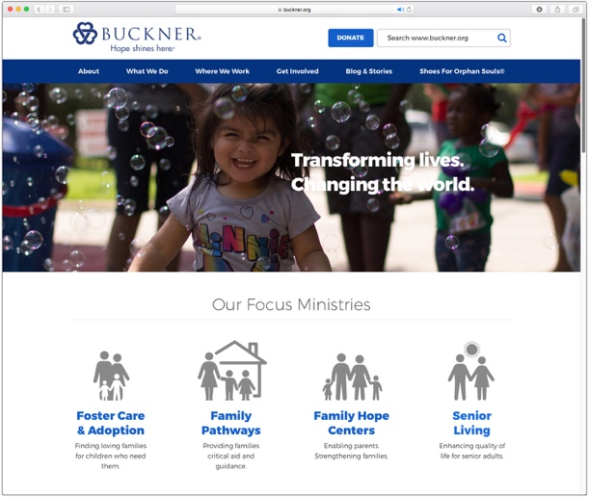
We want to mean hope TOGETHER with you!
We’re looking for people with a passion to serve – individuals, churches, civic groups and others – who are compelled by the needs of the needy. You can:
Volunteer
Host
Support
Tell
at one of our locations or go on a mission trip in the U.S. or internationally.
a Buckner Shoes for Orphan Souls®
drive, collecting new shoes for children.
children and struggling families financially through one of our ministries.
our story to your friends and family.
Find out how at buckner.org

